Slide 1
Planning developmental studies: A Bayesian Perspective
Mike Frank

Slide 2
How many children do I (have to) run?!?

Slide 3
Should this study be done?
An alternative way to think about sample size planning: will this study be informative?
Will your reviewers say:
“Likely wouldn’t have been able to reject the null no matter what”?
“Not precise enough to constrain future work”?
”Wasted participants’ time”?

Slide 4
Outline
The (flawed) classic approach: Power analysis
General alternative strategies
How Bayesian methods can help: Sequential testing

Slide 5
Outline
The (flawed) classic approach: Power analysis
General alternative strategies
How Bayesian methods can help: Sequential testing

Slide 6
Classic NHST
Truth
Null is true Null is false
Type I error | Correct
Correct | Type II error
Null is true Null is false
False positive
Experimental result
False negative
Remember: p val is the probability of the data (or any more extreme) under the null

Slide 7
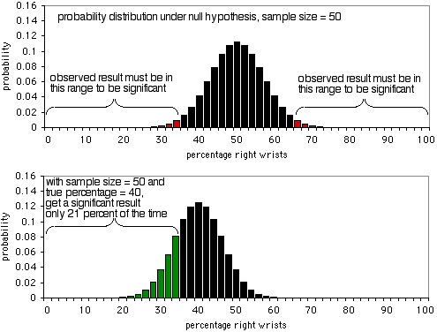
Quick illustration

Slide 8
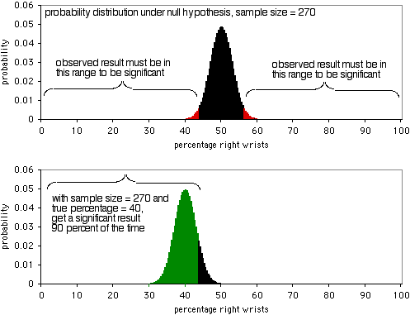
Quick illustration

Slide 9
The big problem
We don’t know the real effect size!

Slide 10
The (other) big problem
The real effect size may be 0
(and if so, we want to accept the null)

Slide 11
Potential sources of effect sizes
Meta-analysis of previous literature
Previous finding you’re trying to replicate
General sense of the effect size you care about
Pilot data

Slide 12
Potential sources of effect sizes
Meta-analysis of previous literature
Great if you have it
But rare to have this and still be planning a study of same effect
Still subject to potential publication bias (so MA effect might be inflated)
Previous finding you’re trying to replicate
General sense of the effect size you care about
Pilot data

Slide 13
Potential sources of effect sizes
Meta-analysis of previous literature
Previous finding you’re trying to replicate
Very likely to be an inflated effect
Can adjust for inflation (e.g. Biesanz & Shrager ms)
Still very unlikely to be a precise estimate
General sense of the effect size you care about
Pilot data

Slide 14
Potential sources of effect sizes
Meta-analysis of previous literature
Previous finding you’re trying to replicate
General sense of the effect size you care about
Average effect is often small (d=.5)
Might want to do a “smallest effect size of interest” (SESOI) analysis
Planning for an average effect just ends up a recipe for relatively underpowered studies
Pilot data

Slide 15
Potential sources of effect sizes
Meta-analysis of previous literature
Previous finding you’re trying to replicate
General sense of the effect size you care about
Pilot data
DON’T DO THIS!
Estimates of effect size for pilots are so noisy that they will do more harm than good!
Cf http://datacolada.org/20

Slide 16
Outline
The (flawed) classic approach: Power analysis
General alternative strategies
How Bayesian methods can help: Sequential testing

Slide 17
Planning a sample
What’s the goal of the study?
To test the existence of an effect
To replicate prior work
To measure a particular effect for comparison to a model
What are the constraints on completing the study?
How long will it take?
How much does each data point cost?
And what’s the opportunity cost?
Answers to these questions determine the right sample size planning method!
Sample size justification ≠ classical power analysis!

Slide 18
Example 1
RCT of educational intervention
High cost
High potential return on investment
Long timescale
Want to know about efficacy of intervention
Sample size planning depends on the literature
Scenario A: Lots of prior knowledge about interventions of this type
Scenario B: New interventionLimited knowledge about effective size
Prior knowledge -> classic power analysis
Less knowledge -> consider power on range of effect sizes up to some smallest effect size of interest (SESOI)

Slide 19
Example 2
Student project with convenience population
Low cost, mostly opportunity cost in terms of time
Limited prior knowledge
Cost-based sample planning probably most appropriate
Can analyze expected power under these costs
Consider sequential analysis (next section) to minimize costs

Slide 20



Example sample size justification
We did not have strong prior information about the likely effect size for our manipulation, thus we use a “smallest effect size of interest” analysis.
Because of our interest in meaningful factors affecting word learning, we were interested in effect sizes as small as d=.3.
We were also limited by our ability to collect data in only a single preschool.
We calculated that based on our maximal sample size of N=80, we would achieve 75% power for d=.3, 90% power for d=.5, and >95% power for d=.6 and above.
goal
constraint

Slide 21
Outline
The (flawed) classic approach: Power analysis
General alternative strategies
How Bayesian methods can help: Sequential testing

Slide 22
Sequential Bayes Factor Designs
Very strong H₁
Strong H₁
Moderate H₁
1/5 < BF < 5
BF₁₀ = P(D|H₁)
P(D|H₀)
Anecdotal H₁
Anecdotal H₀
Moderate H₀
Strong H₀
n=20
Very strong H₀
Adapted from Schönbrodt et al. (2017); Lee & Wagemkakers, 2013
+ 1
Default JZS prior on effect size + sensitivity analyses across range of scaling factors
BayesFactor R package
Slides adapted with permission from Mani (vICIS): https://osf.io/7aub4/

Slide 23
Sequential Bayes Factor Designs
Not constrained by pre-specified (usually incorrect) ES: continue testing until convinced effect is [not] “there”
Between 50% to 70% more efficient (Schönbrodt et al., 2017)
Flexibility to continue testing even if you have crossed a pre-specified threshold
How does this work? Consistency (Morey & Rouder, 2011, Rouder et al., 2012)
If H1 is true – (JZS) BF converges to ∞ with increasing sample size
If H0 is true – (JZS) BF converges to 0 with increasing sample size

Slide 24


Mispronunciation sensitivity task
Where’s the Oppel?
Swingley & Aslin (2000)
Cross-situational learning task
Madi, Isot
Asan, Isot
Isot, Isot, Isot…
Smith & Yu (2008)
Mani et al. (2021), Dev Sci

Slide 25
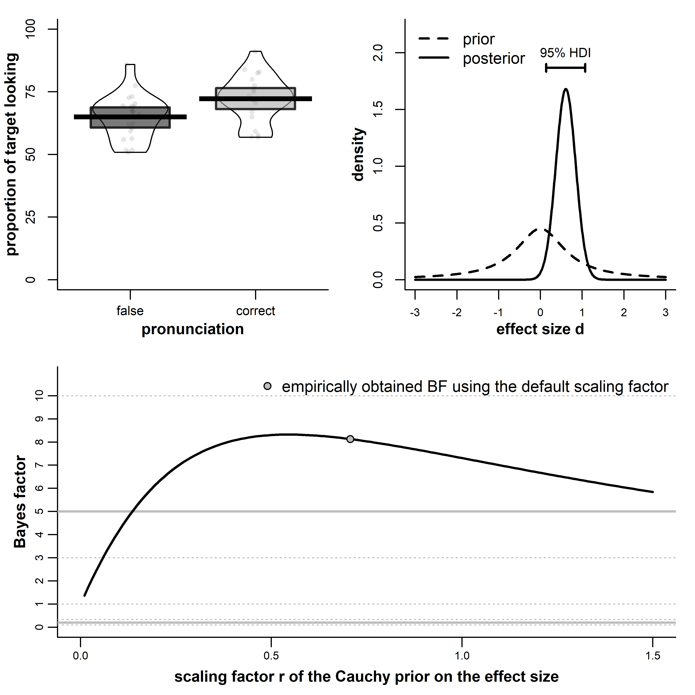
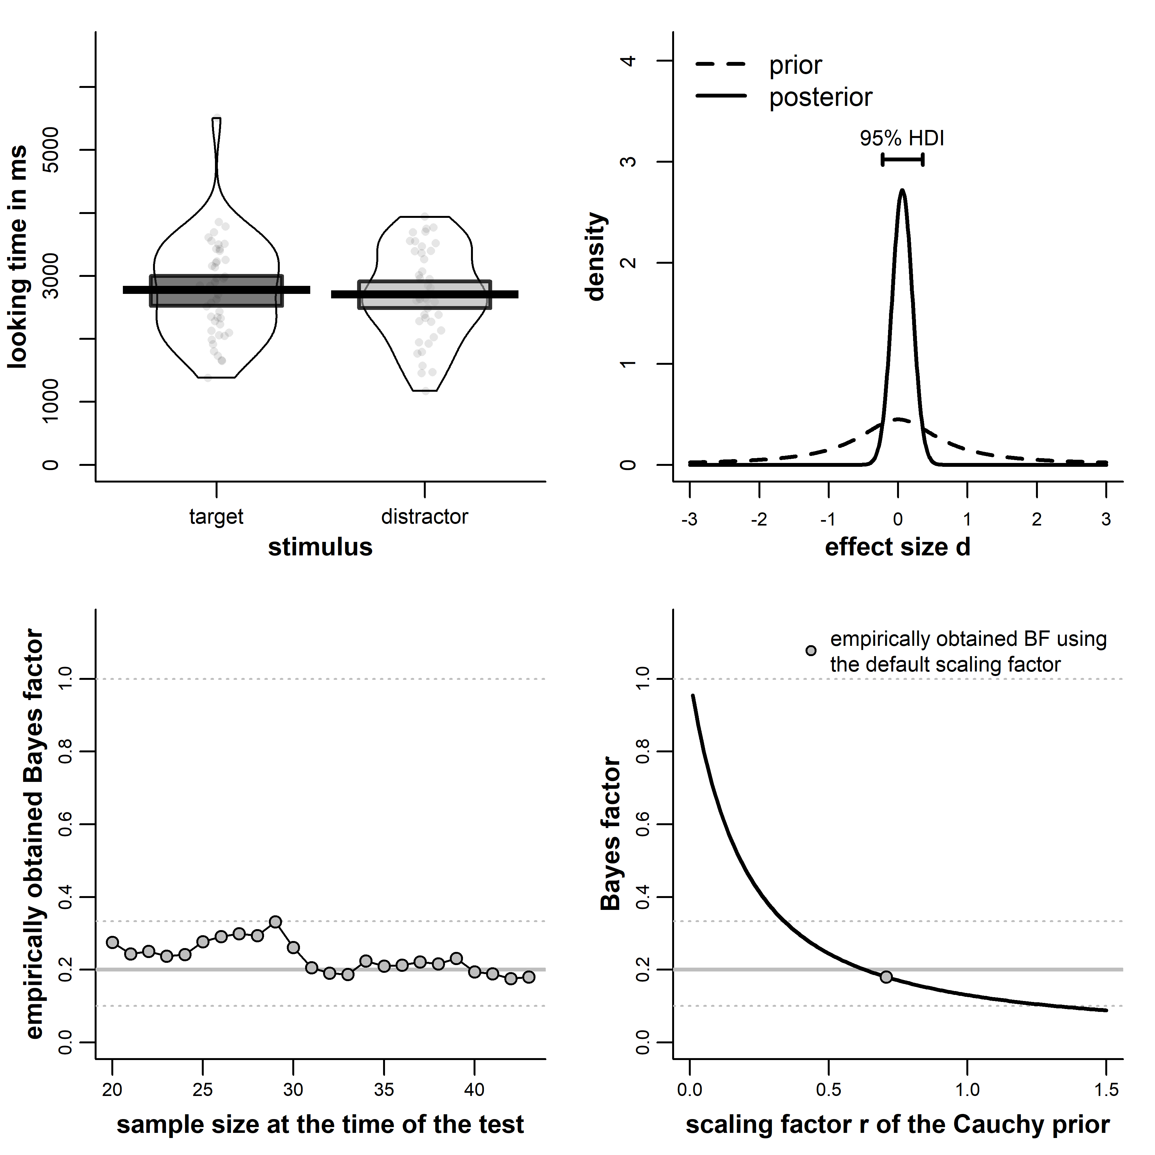
Mispronunciation sensitivity task (final n = 21)
t(20) = 3.10, BF = 8.13, d = 0.61, 95% HDI [0.14, 1.07]
Cross-situational learning task (final n = 43)
t(42) = 0.43, BF = 0.18, d = 0.06, 95% HDI [-0.22; 0.35]

Slide 26
Take-homes
The (flawed) classic approach: Power analysis
General alternatives: goal-based planning
State goals and constraints of analysis
How Bayesian methods can help
Sequential testing using Bayes Factors
Easy and efficient way to gather evidence for or against the null

